Slide 1
Space Weather and Aviation Impacts
Char Dewey
NOAA/National Weather Service Salt Lake City, UT
@DeweyWx
charlotte.dewey@noaa.gov
IWAWS 2018

Slide 2
Space Weather and Aviation Impacts
What is space weather?
How space weather affects Earth and aviation; hazards and impacts
How to monitor conditions and be space weather-aware

Slide 3
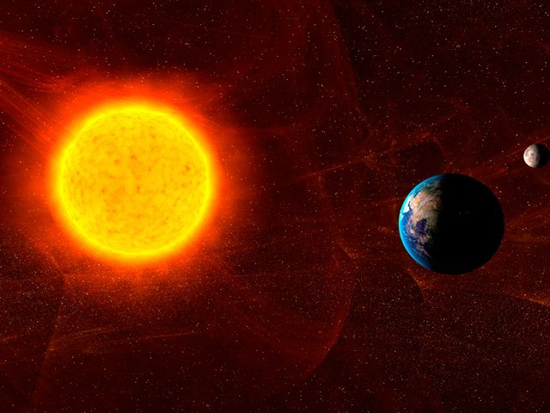
Space Weather 101

Slide 4
Space Weather 101
Weather originating from the Sun and traveling the 93 million miles to reach Earth and our atmosphere, interacting with systems on and orbiting Earth.
Observations come from satellite sources with instruments that monitor space weather.
Model data (some now operational!) developing.
Coronal Mass Ejections (CME), Solar Energetic Particles (SEP), and Solar Flares.

Slide 5
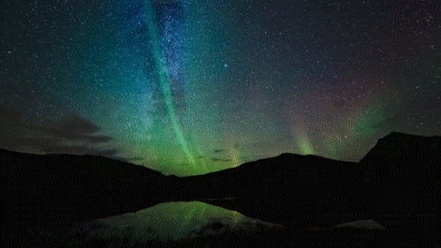

Slide 6
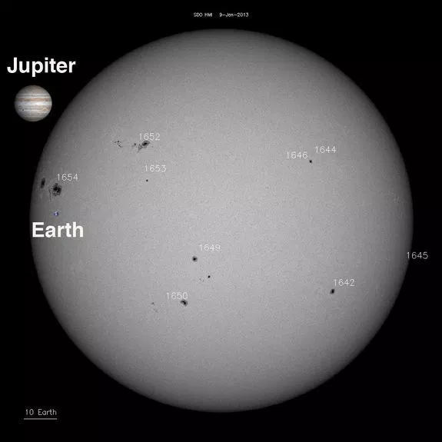
Space Weather 101
Active regions on the sun are where solar activity begins; where sunspots are located on the solar disk.
Magnetic “instability” where solar storming forms.

Slide 7
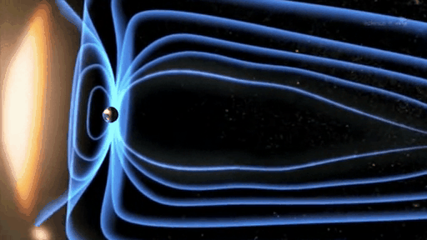
Space Weather 101
Coronal Mass Ejections (CME)
An eruption of plasma particles and electromagnetic radiation from the solar corona, often following solar flares.
Originate from active regions on the Sun’s surface (sunspots).
Very slow to reach the Earth from 12 hours to days or a week.

Slide 8
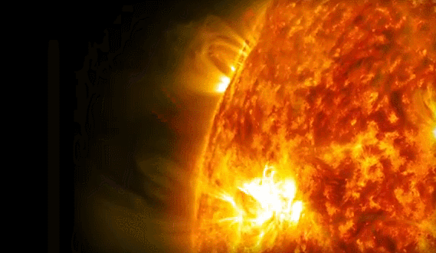
Space Weather Impacts
Coronal Mass Ejections (CME)
Impacts: Geomagnetic storming compresses Earth’s magnetosphere on the day-side, extending night-side “tail” and reconnecting, focusing energy at the poles and resulting in Aurora. Increase electrons in the ionosphere at high-latitude regions, exposing to higher radiation values.

Slide 9
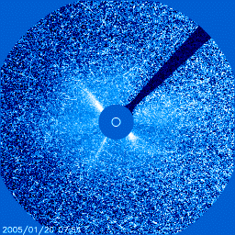
Space Weather 101
Solar Energetic Particles (SEP)
High-energy particles; protons, electrons
Originate from solar flare or shock wave (CME) reaching the Earth from 20 minutes to many hours, depending the location it leaves the solar disk.
Proton detectors on the GOES geostationary and NOAA polar orbiting satellites.

Slide 10
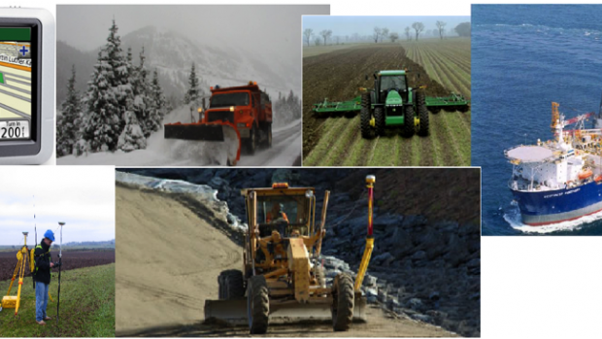
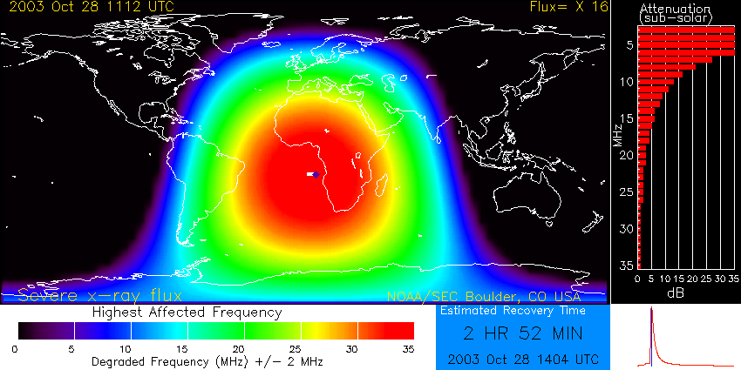
Space Weather Impacts
Solar Energetic Particles (SEP)
Impacts: GPS receivers used by nearly every cell phone, automobile, onboard ships, high-precision positioning such as offshore drilling, surveying to name a few. Radio signals pass through ionosphere, which becomes bent and inaccurate.

Slide 11
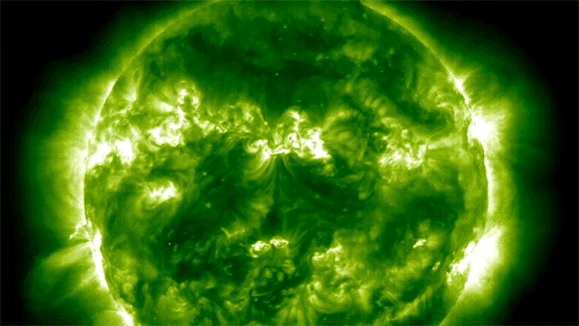
Space Weather 101
Solar Flare
Large solar flares can block HF radio transmissions on the sunlit side of Earth.
Associated with CMEs.
Cause satellite communication and radio navigation issues.
Duration of the entire solar flare impacts can be from seconds to an hour or so.

Slide 12
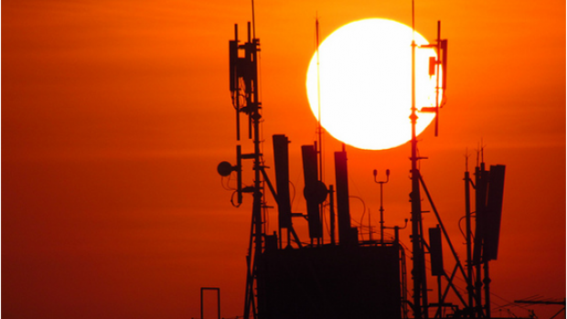
Space Weather Impacts
Solar Flare
Impacts: radio communications at high frequency (1-30 mega Hertz) on day side of Earth

Slide 13
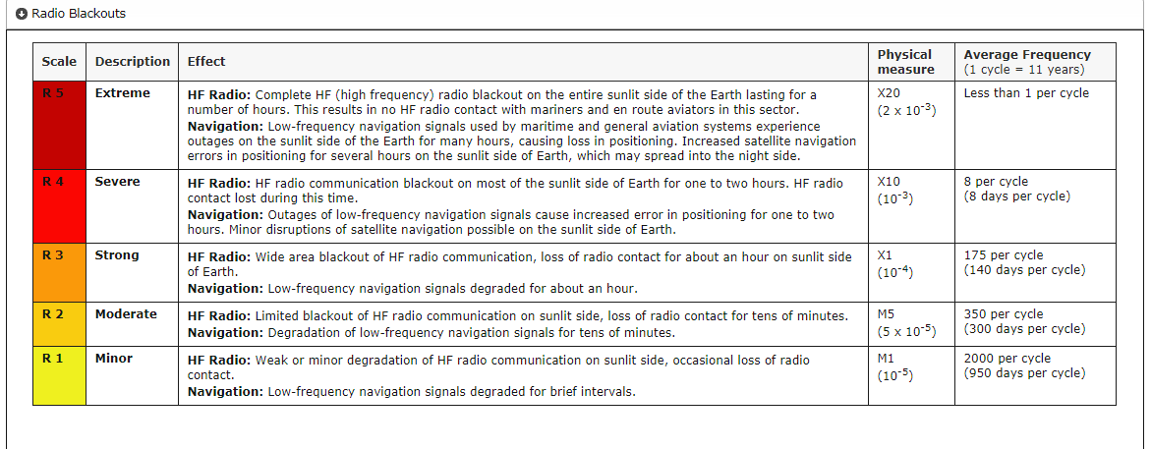
Space Weather 101
Solar Cycle: 22-year cycle
Space Weather Scales (think hurricane and tornado intensity) from 1 (weakest) to 5 (strongest)
Radio Blackouts - R-scale (Solar flares)
Solar Radiation Storms - S-scale (particle events)
Geomagnetic Storms - G-scale (CME)
https://www.swpc.noaa.gov/noaa-scales-explanation

Slide 14
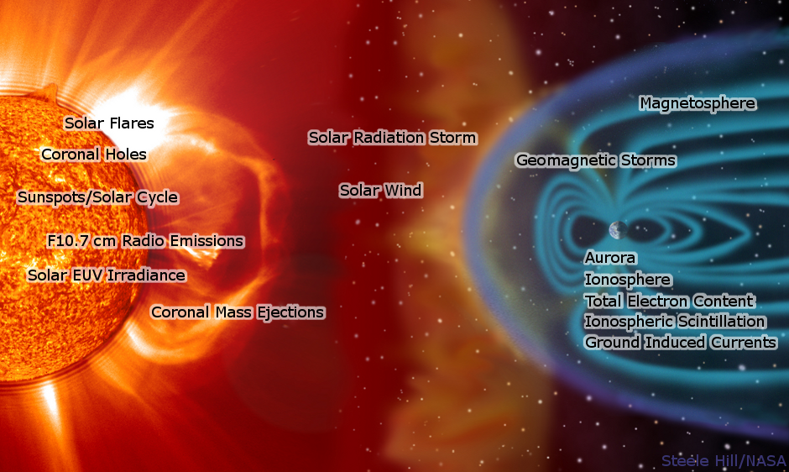
Hazards Impacts

Slide 15
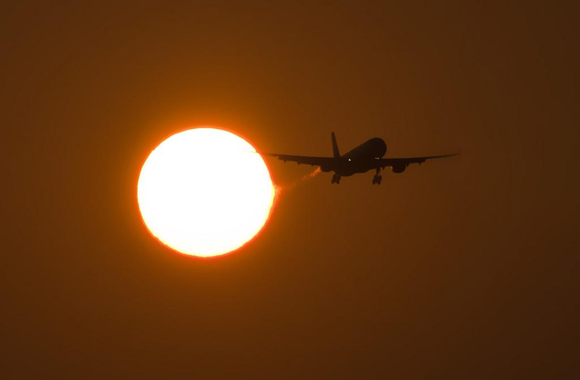
Space Weather Affects: Earth and Aviation
High latitude flights more susceptible to effects from Space Weather
Customers: Airlines, satellite operations, NASA, GPS applications, power utilities, oil pipelines, FEMA, Aurora viewing enthusiast, pigeon racers.

Slide 16
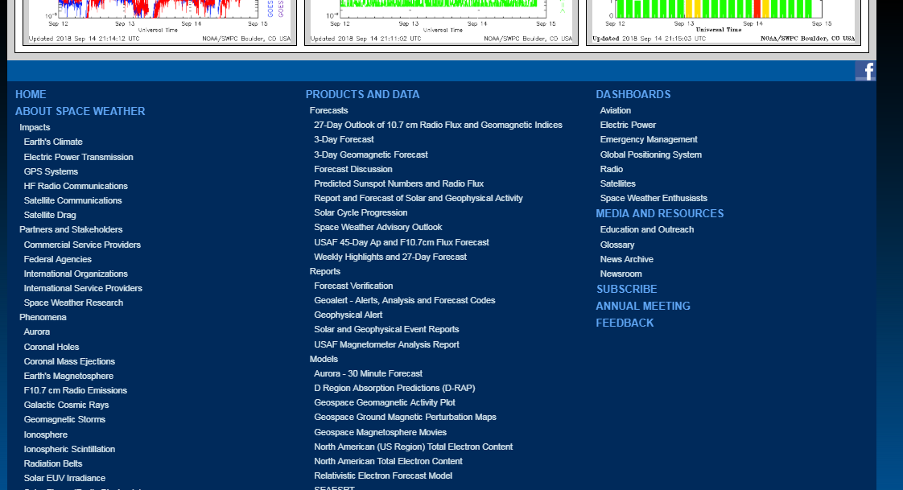
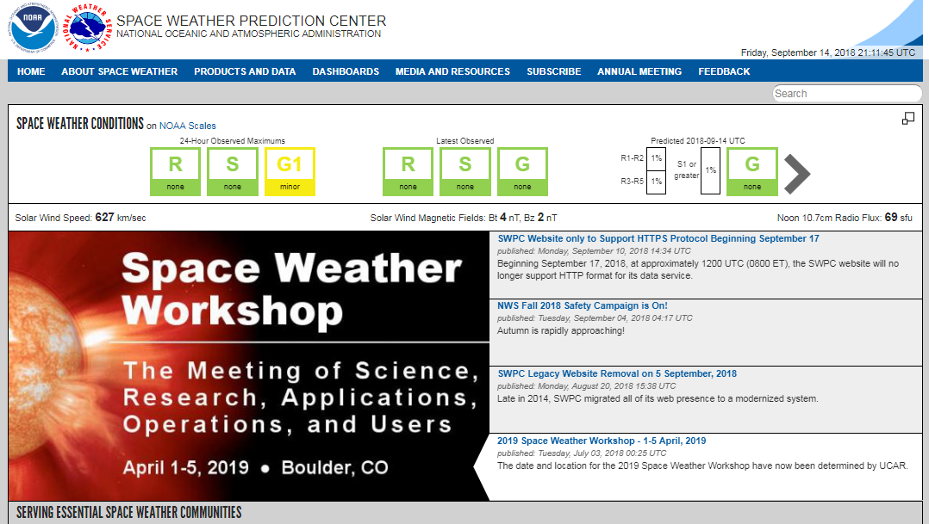
Space Weather
Monitoring
https://www.swpc.noaa.gov/

Slide 17
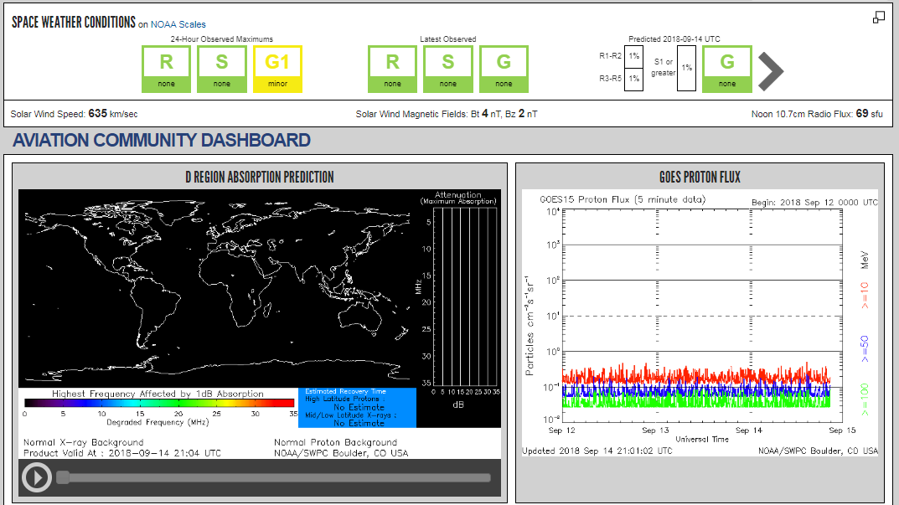
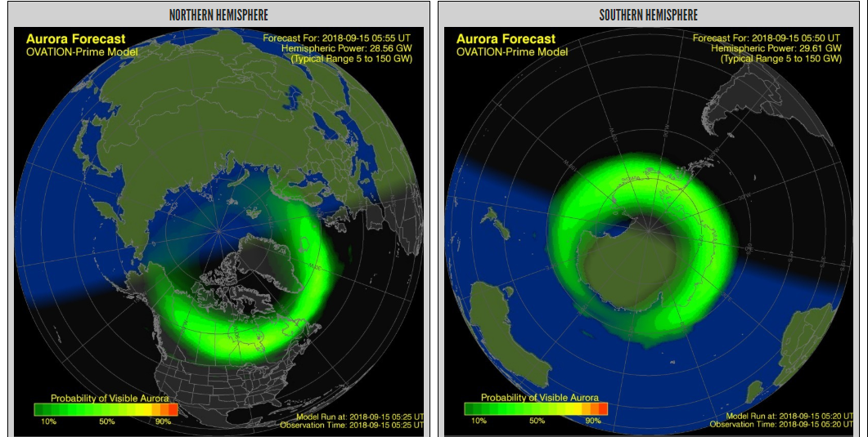
Space Weather
Monitoring
Tools to benefit aviation community for space weather
https://www.swpc.noaa.gov/communities/aviation-community-dashboard

Slide 18
Space Weather and Aviation Impacts
Charlotte Dewey
Forecaster, NOAA/NWS Salt Lake City, UT
charlotte.dewey@noaa.gov
@DeweyWx
https://www.swpc.noaa.gov/

